Slide 1
RESTful Web Services

Slide 2
Agenda
Introduction
What is REST?
How does it work?
RESTful Architecture
REST vs SOAP
REST – Why and When?

Slide 3
Introduction
In this modern world, enterprises are in the need of implementing Service Oriented Architecture (SOA) to achieve maximum business benefits
SOAP/WSDL/UDDI - SOA stack is the most common way and have failed to live up to their promise in some cases
Due to the complexity and high cost, enterprises are looking at alternatives to build their integration architecture in a simpler way.
In order to achieve low-cost, flexible integration, increased data security, and greater scalability, there is tremendous interest in REpresentational State Transfer (REST) architectural style

Slide 4
What is REST?
REST stands for “REpresentational State Transfer”, was introduced and defined in 2000 by the doctoral dissertation of Roy Fielding
REST is an architectural style which has set of constraints that can be applied on networking architecture to create RESTful architecture typically, on client server architecture.
Notes:
The most important concept of REST is resources, which are identified by global IDs typically using URIs.
URIs are used to connect clients and servers to exchange resources in the form of representations, various representations could be XML, JSON, HTML, TEXT etc.

Slide 5
What is REST?
Representational State Transfer (REST)
a software architecture style for designing scalable distributed applications.
a simpler alternative to SOAP, WSDL-based Web services.
typically based on HTTP, but not always
not a "standard" but is widespread due to its simplicity & ease of use

Slide 6
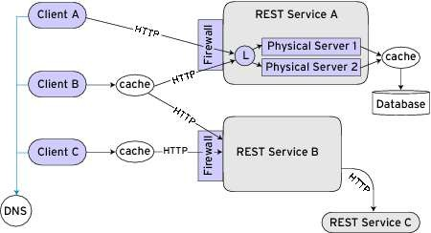
Distributed Applications

Slide 7
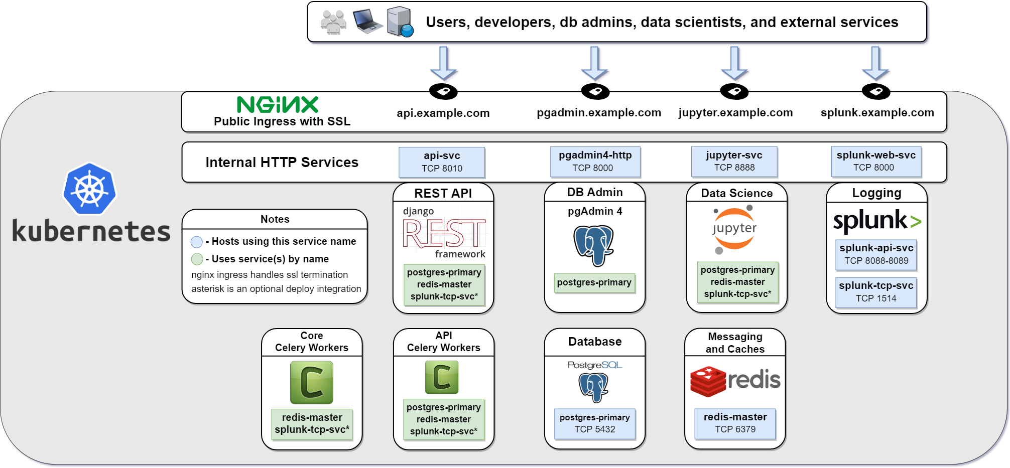
Distributed Applications

Slide 8
How does REST work?
Hyperlink to a resource and the only way of exchange data between client and server
Each resource can be accessed by unique ID called URI
Example:
<domain>/depts/
<domain>/depts/finance
<domain>/employees/senthil
Resources can be anything, simple entity or entities
Actual data of the system and can be in any form
Example: Customer, Orders etc
Representation is a temporal state of the actual data
Representation is sent back and forth between client and server
Example: XML, JSON, Text
REST

Slide 9
REST in action
In REST URIs are used to connect clients and servers to exchange resources in the form of representations
In order to exchange data, REST relies on basic HTTP protocol methods: GET, POST, PUT and DELETE.
Accept header is
used for representation
HTTP method is
used for operation
URI is used to
locate resources
2
3
1
1
2
3

Slide 10
REST in detail (GET/RETRIEVE)
The method GET is used to RETRIEVE resources.
Client application makes a HTTP request with the method type GET and Senthil as the identifier
The representation type is set
through the Accept request header
REST Framework invokes
domain code to retrieve
data and to generate
Representation in XML
Servlet container sends back the
response as XML with 200 as
the status code

Slide 11
RESTful Architecture
uniform interface
stateless
cacheable
client-server
layered systems
code on demand (optional)

Slide 12
Uniform Interface
uniform interface between the client and server
simplification & decoupling of the architecture
in HTTP,
URIs - represent resources
http verbs (GET / POST / PUT / DELETE) - represent actions
http response, status code, headers

Slide 13
Stateless
no client’s state is stored on the server
every request is self contained & self descriptive i.e all requests from clients contain all the information necessary for the server to provide service.
session state is kept entirely on the client

Slide 14
Client-Server
separation of concerns
distributed and disconnected components
encourages components to evolve independently
provides much more:
scalability
maintainability
portability

Slide 15
Cacheable
responses should be cacheable
implicitly or
explicitly

Slide 16
Layered Systems
there could be different layers in between the client and server like proxies, middlewares, services, caches, load balancers etc.
client doesn’t know how the response is being generated, and is not concerned either (separation of concern again)

Slide 17
RESTful Architecture
A typical Java based RESTful architecture consists of 3 layers.
The Restful Service layer intercepts incoming http requests to identify the representation, resource and the operation
Flask/JAX-RS is the
specification defined
create and use
RESTful services in
Python/Java applications.
The Business Layer uses appropriate
framework to execute the business logic.
The Data Layer is responsible for
data logic and takes care of O/R mapping.

Slide 18
REST APIs
application programming interfaces(APIs) that is based upon REST architecture.
platform independent api
i.e client written in Java can communicate with APIs written in PHP, Node
etc.
can be developed using any server-side programming languages: PHP, Ruby, Python, NodeJS, Java, C#(ASP.NET), C++ etc.

Slide 19
REST APIs
URIs - to identify particular resource(s) on the server
resource-based, ie. use resources instead of actions
prefer nouns instead of verbs
HTTP Verbs - to represent actions on those resources
POST - Create a new resource
GET - Read/Fetch resource(s)
PUT | PATCH - Update a resource
DELETE - Delete a resource(s)
responses in: JSON, XML, CSV, HTML etc.

Slide 20
Resources
identification of resources using URIs:
api.foobar.com/users
(identifies collection of resources)
api.foobar.com/users?country=Nepal (resources with query string)
api.foobar.com/users/12 (single resource)
api.foobar.com/users/12/articles
(collection)
api.foobar.com/users/12/articles?published=1
(collection)
api.foobar.com/users/12/articles/2
(single resource)

Slide 21
CRUD Operations
Create
POST
api.foobar.com/users
(Create a new resource)
Read
GET
api.foobar.com/users
(Fetch collection)
(Fetch single resouce)
GET
api.foobar.com/users/44
Update
PUT
api.foobar.com/users/44
(Update specific resource)
Delete
DELETE
api.foobar.com/users/44
(delete single resource)

Slide 22
References
http://en.wikipedia.org/wiki/Representational_state_transfer
http://stackoverflow.com/
http://www.restapitutorial.com/lessons/whatisrest.html
http://rest.elkstein.org/
http://www.ics.uci.edu/~fielding/pubs/dissertation/rest_arch_style.htm
http://www.slideshare.net/shriteshbhattarai/restful-web-architecture
http://laravel.com/docs/5.0/controllers#restful-resource-controllers
https://laracasts.com/lessons/understanding-rest

Slide 23
REST vs SOAP?
Lightweight – easy to develop, no toolkits are required, works based on fundamental principles of HTTP and no contracts involved.
SOAP is complex, it requires greater implementation effort and understanding on the client side and server side.
The XML metadata information and SOAP headers associated with web services are considered to be an overhead than the HTTP headers.
HTTP itself is providing all facilities for an efficient, secured consumption of business logic and data, so SOAP and WS-* are considered overhead.
The stateless, highly scalable RESTful services are adopted in major key players such as Google, Amazon, Microsoft, Digg, Flickr and Twitter

Slide 24
Why and When?
Consider REST:
REST may be considered if the service model is light, stateless, low cost, which requires improved data security and high scalability
Consider SOAP:
REST does not enforce any service contract, if the service model requires stronger service contract between server and client, REST may not be an option.
Some of the SOAP capabilities such as transaction, policy are not standardized in REST
REST operates on stateless model, which may not be friendly for stateful service model

Slide 25
Thank You

